Slide 1






Cloud-Based Library Management System
A Scalable, Containerized Solution on AWS
Software Construction and Development
Team Members:
Muhammad Saqlain Tahir (BSSE-23050)
Zunaira Abdul Aziz (BSSE-23058)
Faiqa Arshad (BSSE-23028)

Slide 2



Introduction
We migrated the traditional Library Management System from old local servers to the AWS Cloud. By using Amazon ECS and RDS, we built a secure, globally accessible solution. The new system now automatically handles high traffic spikes without crashing, eliminating the need for manual maintenance and hardware repairs.

Slide 3

Scalability Crisis:
System frequently crashed during high-traffic periods (e.g., Mid-term/Final exam weeks).
Hardware could not handle concurrent user requests.
Limited Accessibility:
Legacy servers restricted access to the campus network only.
No remote access for students working from home.
Data Vulnerability:
Single-point-of-failure storage.
Lack of automated backups and disaster recovery.
The Problem
Why Migrate to the Cloud?

Slide 4

Our Solution
Scalability: Automate traffic handling using Amazon ECS to support high user loads without crashing.
Data Integrity: Migrate vulnerable local data to Amazon RDS (PostgreSQL) for automated backups and fault tolerance.
Security: Implement strict network isolation using a custom Virtual Private Cloud (VPC).
Modernization: Containerize the application using Docker to ensure consistent deployment across any environment.

Slide 5
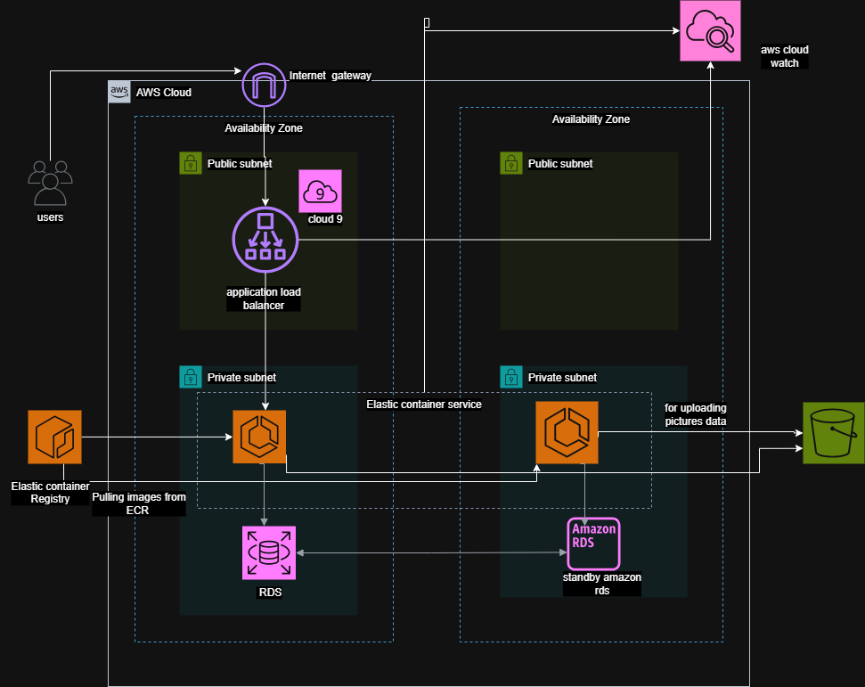
AWS Architecture Design

Slide 6

Implementation Overview
Phase 1: Network Infrastructure
Created a custom VPC (10.0.0.0/16) with Public and Private subnets.
Configured Internet Gateway and NAT Gateway for controlled connectivity.
Phase 2: Database Setup
Launched Amazon RDS in a private subnet.
Restricted traffic via Security Groups to allow connections only from the Application layer (Port 3306/5432).
Phase 3: Containerization
Dockerized the Python application and pushed the image to Amazon ECR (Elastic Container Registry).
Phase 4: Orchestration
Deployed an ECS Service with Auto-Recovery to ensure the application always stays running ("Steady State").

Slide 7

Performance: The Application Load Balancer maintained a response time of <200ms under traffic load.
Reliability: The ECS Service successfully achieved and maintained a "Steady State," automatically recovering from any task failures.
Security: Penetration testing confirmed that the Database is inaccessible from the public internet, verifying the success of the private subnet isolation.
Observability: Amazon CloudWatch successfully captured real-time logs (e.g., "User uploaded image"), providing a full audit trail.
Results & Analysis

